Slide 1
Concurrency: Mutual Exclusion and Synchronization
CHAPTER 5

Slide 2
MULTIPLE PROCESSES
Operating System design is concerned with the management of processes and threads:
Multiprogramming
Multiprocessing
Distributed Processing
Fundamental to all of these areas, and fundamental to OS design, is concurrency.
Notes:
The central themes of operating system design are all concerned with the management of processes and threads:
• Multiprogramming: The management of multiple processes within a uniprocessor system
• Multiprocessing : The management of multiple processes within a multiprocessor
• Distributed processing: The management of multiple processes executing on multiple, distributed computer systems. The recent proliferation of clusters is a prime example of this type of system.

Slide 3
CONCURRENCY AND DESIGN ISSUES
Concurrency encompasses a host of design issues, including;
communication among processes,
sharing of and competing for resources
synchronization of the activities of multiple processes, and
allocation of processor time to processes.

Slide 4
Concurrency Arises in Three Different Contexts:
Multiprogramming was invented to allow processing
time to be dynamically shared among a number of active applications.
Structured Applications
As an extension of the principles of modular design
and structured programming, some applications can be effectively programmed
as a set of concurrent processes.
Operating System Structure
The same structuring advantages apply to systems
programs, and we have seen that operating systems are themselves
often implemented as a set of processes or threads.
Multiple Applications
Notes:
Concurrency arises in three different contexts:
• Multiple applications: Multiprogramming was invented to allow processing time to be dynamically shared among a number of active applications.
• Structured applications: As an extension of the principles of modular design and structured programming, some applications can be effectively programmed as a set of concurrent processes.
Operating system structure: The same structuring advantages apply to systems programs, and we have seen that operating systems are themselves often implemented as a set of processes or threads.

Slide 5
Some Key Terms Related to Concurrency

Slide 6
PRINCIPLES OF CONCURRENCY
Interleaving and Overlapping
can be viewed as examples of concurrent processing
both present the same problems
In both multiprogramming and multiprocessing cases, the problems stem from… The relative speed of execution of processes cannot be predicted.
It depends on the activities of other processes, the way in which the OS handles interrupts, and the scheduling policies of the OS.
Notes:
At first glance, it may seem that interleaving and overlapping represent fundamentally different modes of execution and present different problems. In fact, both techniques can be viewed as examples of concurrent processing, and both present the same problems. In the case of a uniprocessor, the problems stem from a basic characteristic of multiprogramming systems: The relative speed of execution of processes cannot be predicted. It depends on the activities of other processes, the way in which the OS handles interrupts, and the scheduling policies of the OS.

Slide 7
Extra Slide
In a single-processor multiprogramming system, processes are interleaved in time to yield the appearance of simultaneous execution
Even though actual parallel processing is not achieved, and even though there is a certain amount of overhead involved in switching back and forth between processes, interleaved execution provides major benefits in processing efficiency and in program structuring.
In a multiple-processor system, it is possible not only to interleave the execution of multiple processes but also to overlap them
All of the foregoing difficulties present themselves in a multiprocessor system as well, because a multiprocessor system must also deal with problems arising from the simultaneous

Slide 8
Difficulties of Concurrency
Sharing of global resources
For example, if two processes both make use of the same global variable and both perform reads and writes on that variable, then the order in which the various reads and writes are executed is critical.
Difficult for the OS to manage the allocation of resources optimally
For example, process A may request use of, and be granted control of, a particular I/O channel and then be suspended before using that channel. It may be undesirable for the OS simply to lock the channel and prevent its use by other processes; indeed this may lead to a deadlock condition
Difficult to locate programming errors
because results are typically not deterministic and
Notes:
The following difficulties arise:
1. The sharing of global resources is fraught with peril. For example, if two processes both make use of the same global variable and both perform reads and writes on that variable, then the order in which the various reads and writes are executed is critical. An example of this problem is shown in the following subsection.
2. It is difficult for the OS to manage the allocation of resources optimally. For example, process A may request use of, and be granted control of, a particular I/O channel and then be suspended before using that channel. It may be undesirable for the OS simply to lock the channel and prevent its use by other processes; indeed this may lead to a deadlock condition, as described in Chapter 6 .
3. It becomes very difficult to locate a programming error because results are typically not deterministic and reproducible (e.g., see [LEBL87, CARR89, SHEN02] for a discussion of this point).
All of the foregoing difficulties present themselves in a multiprocessor system as well, because here too the relative speed of execution of processes is unpredictable. A multiprocessor system must also deal with problems arising from the simultaneous execution of multiple processes. Fundamentally, however, the problems are the same as those for uniprocessor systems. This should become clear as the discussion proceeds.

Slide 9
A Simple Example
Consider the following procedure:
Any program can call this procedure repeatedly to accept user input and display it on the user’s screen.
Now consider that we have a single-processor multiprogramming system supporting a single user. The user can jump from one application to another, and each application uses the same keyboard for input and the same screen for output.
Because each application needs to use the procedure echo, it makes sense for it to be a shared procedure that is loaded into a portion of memory global to all applications. Thus, only a single copy of the echo procedure is used, saving space.
The sharing of main memory among processes is useful to permit efficient and close interaction among processes. However, such sharing can lead to problems.

Slide 10
A Simple Example
Consider the following procedure:
Process P1 invokes the echo procedure and is interrupted immediately after getchar returns its value and stores it in chin. At this point, the most recently entered character, x, is stored in variable chin.
2. Process P2 is activated and invokes the echo procedure, which runs to conclusion, inputting and then displaying a single character, y, on the screen.
3. Process P1 is resumed. By this time, the value x has been overwritten in chin and therefore lost. Instead, chin contains y, which is transferred to chout and displayed.
The essence of this problem is the shared global variable, chin.

Slide 11
A Simple Example
Suppose, however, that we permit only one process at a time to be in that procedure. Then the foregoing sequence would result in the following:
Process P1 invokes the echo procedure and is interrupted immediately after the conclusion of the input function. At this point, the most recently entered character, x, is stored in variable chin.
Process P2 is activated and invokes the echo procedure. However, because P1 is still inside the echo procedure, although currently suspended, P2 is blocked from entering the procedure. Therefore, P2 is suspended awaiting the availability of the echo procedure.
At some later time, process P1 is resumed and completes execution of echo. The proper character, x, is displayed.
When P1 exits echo, this removes the block on P2. When P2 is later resumed, the echo procedure is successfully invoked.
This example shows that it is necessary to protect shared global variables (and other shared global resources) and that the only way to do that is to control the code that accesses the variable.
How that discipline may be imposed is a major topic of this chapter.
Consider the following procedure:

Slide 12
An other Example
First, suppose that there is no mechanism for controlling access to the shared global variable:
Processes P1 and P2 are both executing, each on a separate processor. Both processes invoke the echo procedure.
The following events occur; events on the same line take place in parallel:

Slide 13
Solution
In the case of a uniprocessor system, the reason we have a problem is that an interrupt can stop instruction execution anywhere in a process.
In the case of a multiprocessor system, we have that same condition and, in addition, a problem can be caused because two processes may be executing simultaneously and both trying to access the same global variable.
However, the solution to both types of problem is the same: control access to the shared resource.

Slide 14
Race Condition
A race condition occurs when multiple processes or threads read and write data items so that the final result depends on the order of execution of instructions in the multiple processes.
Example 1:
suppose that two processes, P1 and P2, share the global variable a.
At some point in its execution, P1 updates a to the value 1, and at some point in its execution
P2 updates a to the value 2.
Thus, the two tasks are in a race to write variable a.
The “loser” of the race (the process that updates last) determines the final value of a.
Example 2:
consider two processes, P3 and P4, that share global variables b and c, with initial values b = 1 and c = 2.
At some point in its execution, P3 executes the assignment b = b + c,
At some point in its execution, P4 executes the assignment c = b + c.
Note that the two processes update different variables. However, the final values of the two variables depend on the order in which the two processes execute these two assignments.
Notes:
A race condition occurs when multiple processes or threads read and write data items so that the final result depends on the order of execution of instructions in the multiple processes. Let us consider two simple examples.
As a first example, suppose that two processes, P1 and P2, share the global variable a . At some point in its execution, P1 updates a to the value 1, and at some point in its execution, P2 updates a to the value 2. Thus, the two tasks are in a race to write variable a . In this example, the “loser” of the race (the process that updates last) determines the final value of a .
For our second example, consider two process, P3 and P4, that share global variables b and c , with initial values b = 1 and c = 2 . At some point in its execution, P3 executes the assignment b = b + c , and at some point in its execution, P4 executes the assignment c = b + c . Note that the two processes update different variables. However, the final values of the two variables depend on the order in which the two processes execute these two assignments. If P3 executes its assignment statement first, then the final values are b = 3 and c = 5 . If P4 executes its assignment statement first, then the final values are b = 4 and c = 3 .
Appendix A includes a discussion of race conditions using semaphores as an example.

Slide 15
Operating System Concerns
Design and management issues raised by the existence of concurrency:
The OS must:
be able to keep track of various processes
allocate and de-allocate resources for each active process
protect the data and physical resources of each process against interference by other processes
ensure that the processes and outputs are independent of the processing speed
Notes:
What design and management issues are raised by the existence of concurrency?
We can list the following concerns:
1. The OS must be able to keep track of the various processes. This is done with the use of process control blocks and was described in Chapter 4 .
2. The OS must allocate and de-allocate various resources for each active process.
At times, multiple processes want access to the same resource. These resources include
• Processor time: This is the scheduling function, discussed in Part Four.
• Memory: Most operating systems use a virtual memory scheme. The topic is addressed in Part Three.
• Files: Discussed in Chapter 12 .
• I/O devices: Discussed in Chapter 11 .
3. The OS must protect the data and physical resources of each process against
unintended interference by other processes. This involves techniques that relate to memory, files, and I/O devices. A general treatment of protection is found in Part Seven .
4. The functioning of a process, and the output it produces, must be independent
of the speed at which its execution is carried out relative to the speed of other
concurrent processes. This is the subject of this chapter.

Slide 16
Process Interaction
To understand how the issue of speed independence can be addressed, we need to look at the ways in which processes can interact.
We can classify the ways in which processes interact on the basis of the degree to which they are aware of each other’s existence.
Table on the next slide lists three possible degrees of awareness plus the consequences of each:

Slide 17
Process Interaction
Notes:
We can classify the ways in which processes interact on the basis of the degree to which they are aware of each other’s existence. Table 5.2 lists three possible degrees of awareness plus the consequences of each:
• Processes unaware of each other: These are independent processes that are not
intended to work together. The best example of this situation is the multiprogramming of multiple independent processes. These can either be batch jobs or interactive sessions or a mixture. Although the processes are not working together, the OS needs to be concerned about competition for resources. For example, two independent applications may both want to access the same disk or file or printer. The OS must regulate these accesses.
• Processes indirectly aware of each other: These are processes that are not necessarily
aware of each other by their respective process IDs but that share access to some object, such as an I/O buffer. Such processes exhibit cooperation in sharing the common object.
• Processes directly aware of each other: These are processes that are able to
communicate with each other by process ID and that are designed to work jointly on some activity. Again, such processes exhibit cooperation .
Conditions will not always be as clear-cut as suggested in Table 5.2 . Rather, several processes may exhibit aspects of both competition and cooperation. Nevertheless, it is productive to examine each of the three items in the preceding list separately and determine their implications for the OS.

Slide 18
Resource Competition
Concurrent processes come into conflict when they are competing for use of the same resource
for example: I/O devices, memory, processor time, clock
In the case of competing processes three control problems must be faced:
the need for mutual exclusion
deadlock
starvation
Notes:
Two or more processes need to access a resource during the course of their execution.
Each process is unaware of the existence of other processes, and each is to be unaffected by the execution of the other processes.
It follows from this that each process should leave the state of any resource that it uses unaffected.
Examples of resources include I/O devices, memory, processor time, and the clock.
There is no exchange of information between the competing processes. However, the execution of one process may affect the behavior of competing processes. In particular, if two processes both wish access to a single resource, then one process will be allocated that resource by the OS, and the other will have to wait. Therefore, the process that is denied access will be slowed down. In an extreme case, the blocked process may never get access to the resource and hence will never terminate successfully.
In the case of competing processes three control problems must be faced. First is the need for mutual exclusion . Suppose two or more processes require access to a single non-sharable resource, such as a printer.
During the course of execution, each process will be sending commands to the I/O device, receiving status information, sending data, and/or receiving data.
We will refer to such a resource as a critical resource , and the portion of the program that uses it as a critical section of the program. It is important that only one program at a time be allowed in its critical section.
We cannot simply rely on the OS to understand and enforce this restriction because the detailed requirements may not be obvious.
In the case of the printer, for example, we want any individual process to have control of the printer while it prints an entire file. Otherwise, lines from competing processes will be interleaved.
The enforcement of mutual exclusion creates two additional control problems. One is that of deadlock . For example, consider two processes, P1 and P2, and two resources, R1 and R2. Suppose that each process needs access to both resources to perform part of its function. Then it is possible to have the following situation: the OS assigns R1 to P2, and R2 to P1. Each process is waiting for one of the two resources. Neither will release the resource that it already owns until it has acquired the other resource and performed the function requiring both resources. The two processes are deadlocked.
A final control problem is starvation . Suppose that three processes (P1, P2, P3) each require periodic access to resource R. Consider the situation in which P1 is in possession of the resource, and both P2 and P3 are delayed, waiting for that resource. When P1 exits its critical section, either P2 or P3 should be allowed access to R. Assume that the OS grants access to P3 and that P1 again requires access before P3 completes its critical section. If the OS grants access to P1 after P3 has finished, and subsequently alternately grants access to P1 and P3, then P2 may indefinitely be denied access to the resource, even though there is no deadlock situation.

Slide 19
Control of competition inevitably involves the OS because it is the OS that allocates resources.
In addition, the processes themselves will need to be able to express the requirement for mutual exclusion in some fashion, such as locking a such as locking a resource prior to its use.
Any solution will involve some support from the OS, such as the provision of the locking facility.

Slide 20
Illustration of Mutual Exclusion
Notes:
Control of competition inevitably involves the OS because it is the OS that allocates resources. In addition, the processes themselves will need to be able to express the requirement for mutual exclusion in some fashion, such as locking a resource prior to its use. Any solution will involve some support from the OS, such as the provision of the locking facility.
Figure 5.1 illustrates the mutual exclusion mechanism in abstract terms. There are n processes to be executed concurrently. Each process includes (1) a critical section that operates on some resource Ra, and (2) additional code preceding and following the critical section that does not involve access to Ra. Because all processes access the same resource Ra, it is desired that only one process at a time be in its critical section. To enforce mutual exclusion, two functions are provided: entercritical and exitcritical . Each function takes as an argument the name of the resource that is the subject of competition. Any process that attempts to enter its critical section while another process is in its critical section, for the same resource, is made to wait.
It remains to examine specific mechanisms for providing the functions entercritical and exitcritical . For the moment, we defer this issue while we consider the other cases of process interaction.

Slide 21
COOPERATION AMONG PROCESSES BY SHARING

Slide 22
COOPERATION AMONG PROCESSES BY SHARING
The case of cooperation by sharing covers processes that interact with other processes without being explicitly aware of them.
For example, multiple processes may have access to shared variables or to shared files or databases.
Processes may use and update the shared data without reference to other processes but know that other processes may have access to the same data.
Thus the processes must cooperate to ensure that the data they share are properly managed.
The control mechanisms must ensure the integrity of the shared data.
Because data are held on resources (devices, memory), the control problems of mutual exclusion, deadlock, and starvation are again present.
The only difference is that data items may be accessed in two different modes, reading and writing, and only writing operations must be mutually exclusive.

Slide 23
Example: Cooperation Among Processes By Sharing
Consider a bookkeeping application in which various data items may be updated.
Suppose two items of data a and b are to be maintained in the relationship a = b.
That is, any program that updates one value must also update the other to maintain the relationship. Now consider the following two processes:
If the state is initially consistent, each process taken separately will leave the shared data in a consistent state.

Slide 24
Example: Cooperation Among Processes By Sharing
Now consider the following concurrent execution sequence, in which the two processes respect mutual exclusion on each individual data item (a and b):
At the end of this execution sequence, the condition a = b no longer holds.
For example, if we start with a = b = 1, at the end of this execution sequence we have a = 4 and b = 3.
The problem can be avoided by declaring the entire sequence in each process to be a critical section.

Slide 25
Cooperation Among Processes By Sharing
Thus, we see that the concept of critical section is important in the case of cooperation by sharing.
The same abstract functions of entercritical and exitcritical discussed earlier can be used here.
In this case, the argument for the functions could be a variable, a file, or any other shared object.
Furthermore, if critical sections are used to provide data integrity, then there may be no specific resource or variable that can be identified as an argument. In that case, we can think of the argument as being an identifier that is shared among concurrent processes to identify critical sections that must be mutually exclusive.

Slide 26
COOPERATION AMONG PROCESSES BY COMMUNICATION

Slide 27
COOPERATION AMONG PROCESSES BY COMMUNICATION
Typically, communication can be characterized as consisting of messages of some sort.
Primitives for sending and receiving messages may be provided as part of the programming language or provided by the OS kernel.
Because nothing is shared between processes in the act of passing messages, mutual exclusion is not a control requirement for this sort of cooperation.
However, the problems of deadlock and starvation are still present.
As an example of deadlock, two processes may be blocked, each waiting for a communication from the other.

Slide 28
REQUIREMENTS FOR MUTUAL EXCLUSION

Slide 29
Requirements For Mutual Exclusion
Any facility that is to provide support for mutual exclusion should meet the following requirements:
Mutual exclusion must be enforced: Only one process at a time is allowed into its critical section, among all processes that have critical sections for the same resource or shared object.
A process that halts in its noncritical section must do so without interfering with other processes.
It must not be possible for a process requiring access to a critical section to be delayed indefinitely: no deadlock or starvation.
When no process is in a critical section, any process that requests entry to its critical section must be permitted to enter without delay.
No assumptions are made about relative process speeds or number of processors.
A process remains inside its critical section for a finite time only.

Slide 30
Ways to Achieve Mutual Exclusion
One approach is to leave the responsibility with the processes that wish to execute concurrently.
Processes, whether they are system programs or application programs, would be required to coordinate with one another to enforce mutual exclusion, with no support from the programming language or the OS.
We can refer to these as software approaches.
Although this approach is prone to high processing overhead and bugs, it is nevertheless useful to examine such approaches to gain a better understanding of the complexity of concurrent processing.
A second approach involves the use of special purpose machine instructions.
These have the advantage of reducing overhead but nevertheless will be shown to be unattractive as a general-purpose solution; they are covered in next Section.
A third approach is to provide some level of support within the OS or a programming language.

Slide 31
MUTUAL EXCLUSION THROUGH HARDWARE SUPPORT
Two interesting hardware approaches to mutual exclusion are:
Interrupt Disabling
Special Machine Instructions

Slide 32
Mutual Exclusion: Hardware Support: Interrupt Disabling
In a uniprocessor system, to guarantee mutual exclusion, it is sufficient to prevent a process from being interrupted.
This capability can be provided in the form of primitives defined by the OS kernel for disabling and enabling interrupts.
A process can then enforce mutual exclusion in the following way;
Disadvantages:
the efficiency of
execution could be
noticeably degraded
this approach will not
work in a multiprocessor
architecture
Notes:
In a uniprocessor system, concurrent processes cannot have overlapped execution;
they can only be interleaved. Furthermore, a process will continue to run until it
invokes an OS service or until it is interrupted. Therefore, to guarantee mutual exclusion,
it is sufficient to prevent a process from being interrupted. This capability
can be provided in the form of primitives defined by the OS kernel for disabling and
enabling interrupts.
Because the critical section cannot be interrupted, mutual exclusion is guaranteed.
The price of this approach, however, is high. The efficiency of execution could
be noticeably degraded because the processor is limited in its ability to interleave
processes. Another problem is that this approach will not work in a multiprocessor
architecture. When the computer includes more than one processor, it is possible (and
typical) for more than one process to be executing at a time. In this case, disabled
interrupts do not guarantee mutual exclusion.

Slide 33
Mutual Exclusion: Hardware Support: Special Machine Instructions
In a multiprocessor configuration, several processors share access to a common main memory. There is no interrupt mechanism between processors on which mutual exclusion can be based.
At the hardware level, access to a memory location excludes any other access to that same location.
With this as a foundation, processor designers have proposed several machine instructions that carry out two actions atomically, such as reading and writing or reading and testing, of a single memory location with one instruction fetch cycle.
During execution of the instruction, access to the memory location is blocked for any other instruction referencing that location.

Slide 34
Mutual Exclusion: Hardware Support: Compare & Swap Instruction
a compare is made between a memory value and a test value
if the values are the same a swap occurs
carried out atomically
Notes:
This version of the instruction checks a memory location ( *word ) against a test value ( testval ). If the memory location’s current value is testval, it is replaced with newval ; otherwise it is left unchanged. The old memory value is always returned; thus, the memory location has been updated if the returned value is the same as the test value. This atomic instruction therefore has two parts: A compare is made between a memory value and a test value; if the values are the same, a swap occurs. The entire compare&swap function is carried out atomically—that is, it is not subject to interruption.
Another version of this instruction returns a Boolean value: true if the swap occurred; false otherwise. Some version of this instruction is available on nearly all processor families (x86, IA64, sparc, IBM z series, etc.), and most operating systems use this instruction for support of concurrency.

Slide 35
Hardware Support for Mutual Exclusion: Compare and Swap instruction
Notes:
Figure 5.2a shows a mutual exclusion protocol based on the use of this instruction. A shared variable bolt is initialized to 0. The only process that may enter its critical section is one that finds bolt equal to 0. All other processes attempting to enter their critical section go into a busy waiting mode. The term busy waiting , or spin waiting , refers to a technique in which a process can do nothing until it gets permission to enter its critical section but continues to execute an instruction or set of instructions that tests the appropriate variable to gain entrance. When a process leaves its critical section, it resets bolt to 0; at this point one and only one of the waiting processes is granted access to its critical section. The choice of process depends on which process happens to execute the compare & swap instruction next.
Figure 5.2b shows a mutual exclusion protocol based on the use of an exchange instruction. A shared variable bolt is initialized to 0. Each process uses a local variable key that is initialized to 1. The only process that may enter its critical section is one that finds bolt equal to 0. It excludes all other processes from the critical section by setting bolt to 1. When a process leaves its critical section, it resets bolt to 0, allowing another process to gain access to its critical section.

Slide 36
Special Machine Instruction: Advantages
Applicable to any number of processes on either a single processor or multiple processors sharing main memory
Simple and easy to verify
It can be used to support multiple critical sections; each critical section can be defined by its own variable
Notes:
The use of a special machine instruction to enforce mutual exclusion has a number of advantages:
• It is applicable to any number of processes on either a single processor or multiple processors sharing main memory.
• It is simple and therefore easy to verify.
• It can be used to support multiple critical sections; each critical section can be defined by its own variable.

Slide 37
Special Machine Instruction: Disadvantages
Busy-waiting is employed, thus while a process is waiting for access to a critical section it continues to consume processor time
Starvation is possible when a process leaves a critical section and more than one process is waiting
Deadlock is possible
Notes:
There are some serious disadvantages:
• Busy waiting is employed: Thus, while a process is waiting for access to a critical section, it continues to consume processor time.
Starvation is possible: When a process leaves a critical section and more than one process is waiting, the selection of a waiting process is arbitrary. Thus, some process could indefinitely be denied access.
•
Deadlock is possible: Consider the following scenario on a single-processor system. Process P1 executes the special instruction (e.g., compare & swap, exchange ) and enters its critical section. P1 is then interrupted to give the processor to P2, which has higher priority. If P2 now attempts to use the same resource as P1, it will be denied access because of the mutual exclusion mechanism. Thus, it will go into a busy waiting loop. However, P1 will never be dispatched because it is of lower priority than another ready process, P2.
Because of the drawbacks of both the software and hardware solutions just outlined, we need to look for other mechanisms.

Slide 38
OS and programming language mechanisms that are used to provide concurrency.
Table summarizes mechanisms in common use.

Slide 39
semaphores
Notes:
Dijkstra was concerned with the design of an OS as a collection of cooperating sequential processes and with the development of efficient and reliable mechanisms for supporting cooperation.
These mechanisms can just as readily be used by user processes if the processor and OS make the mechanisms available.

Slide 40
Semaphore
Semaphore s is a variable that has an integer value upon which only three operations are defined:
There is no way to inspect or manipulate semaphores other than these three operations
May be initialized to a nonnegative integer value
The semWait(s) operation decrements the value
The semSignal(s) operation increments the value
Notes:
The fundamental principle is this:
Two or more processes can cooperate by means of simple signals, such that a process can be forced to stop at a specified place until it has received a specific signal.
For signaling, special variables called semaphores are used.
To transmit a signal via semaphore s , a process executes the primitive semSignal(s) .
To receive a signal via semaphore s , a process executes the primitive semWait(s) ; if the corresponding signal has not yet been transmitted, the process is suspended until the transmission takes place.
To achieve the desired effect, we can view the semaphore as a variable that has an integer value upon which only three operations are defined:
1. A semaphore may be initialized to a nonnegative integer value.
2. The semWait operation decrements the semaphore value. If the value becomes negative, then the process executing the semWait is blocked.
Otherwise, the process continues execution.
3. The semSignal operation increments the semaphore value. If the resulting value is less than or equal to zero, then a process blocked by a semWait operation, if any, is unblocked. Other than these three operations, there is no way to inspect or manipulate semaphores.
We explain these operations as follows. To begin, the semaphore has a zero or positive value. If the value is positive, that value equals the number of processes that can issue a wait and immediately continue to execute. If the value is zero, either by initialization or because a number of processes equal to the initial semaphore value have issued a wait, the next process to issue a wait is blocked, and the semaphore value goes negative. Each subsequent wait drives the semaphore value further into minus territory. The negative value equals the number of processes waiting to be unblocked. Each signal unblocks one of the waiting processes when the semaphore value is negative.

Slide 41
Semaphore
A Semaphore s is a variable that has an integer value upon which only three operations are defined:
A semaphore may be initialized to a nonnegative integer value.
The semWait (s)operation decrements the semaphore value.
If the value becomes negative, then the process executing the semWait is blocked. Otherwise, the process continues execution.
The semSignal (s) operation increments the semaphore value.
If the resulting value is less than or equal to zero, then a process blocked by a semWait operation, if any, is unblocked.
Other than these three operations, there is no way to inspect or manipulate semaphores.

Slide 42
We explain these operations as follows.
To begin, the semaphore has a zero or positive value. If the value is positive, that value equals the number of processes that can issue a wait and immediately continue to execute.
If the value is zero, either by initialization or because a number of processes equal to the initial semaphore value have issued a wait, the next process to issue a wait is blocked, and the semaphore value goes negative.
Each subsequent wait drives the semaphore value further into minus territory. The negative value equals the number of processes waiting to be unblocked.
Each signal unblocks one of the waiting processes when the semaphore value is negative.

Slide 43
A Definition of Semaphore Primitives
Notes:
To begin, the semaphore has a zero or positive value. If the value is positive, that value equals the number of processes that can issue a wait and immediately continue to execute.
If the value is zero, either by initialization or because a number of processes equal to the initial semaphore value have issued a wait, the next process to issue a wait is blocked, and the semaphore value goes negative.
Each subsequent wait drives the semaphore value further into minus territory. The negative value equals the number of processes waiting to be unblocked.
Each signal unblocks one of the waiting processes when the semaphore value is negative.

Slide 44
Consequences
There is no way to know before a process decrements a semaphore whether it will block or not
There is no way to know which process will continue immediately on a uniprocessor system when two processes are running concurrently
You don’t know whether another process is waiting so the number of unblocked processes may be zero or one
Notes:
[DOWN08] points out three interesting consequences of the semaphore definition:
• In general, there is no way to know before a process decrements a semaphore whether it will block or not.
After a process increments a semaphore and another process gets woken up, both processes continue running concurrently. There is no way to know which process, if either, will continue immediately on a uniprocessor system.
• When you signal a semaphore, you don’t necessarily know whether another process is waiting, so the number of unblocked processes may be zero or one.

Slide 45
Binary Semaphore
A more restricted version, known as the binary semaphore
A binary semaphore may only take on the values 0 and 1 and can be defined by the following three operations:
A binary semaphore may be initialized to 0 or 1.
The semWaitB operation checks the semaphore value. If the value is zero, then the process executing the semWaitB is blocked. If the value is one, then the value is changed to zero and the process continues execution.
The semSignalB operation checks to see if any processes are blocked on this semaphore (semaphore value equals 0). If so, then a process blocked by a semWaitB operation is unblocked. If no processes are blocked, then the value of the semaphore is set to one.

Slide 46
Binary Semaphore
Notes:
A binary semaphore may be initialized to 0 or 1.
The semWaitB operation checks the semaphore value. If the value is zero, then the process executing the semWaitB is blocked. If the value is one, then the value is changed to zero and the process continues execution.
The semSignalB operation checks to see if any processes are blocked on this semaphore (semaphore value equals 0). If so, then a process blocked by a semWaitB operation is unblocked. If no processes are blocked, then the value of the semaphore is set to one.

Slide 47
Mutex
A concept related to the binary semaphore is the mutual exclusion lock (mutex).
A mutex is a programming flag used to grab and release an object.
When data are acquired that cannot be shared or processing is started that cannot be performed simultaneously elsewhere in the system, the mutex is set to lock (typically zero), which blocks other attempts to use it.
The mutex is set to unlock when the data are no longer needed or the routine is finished.
A key difference between the a mutex and a binary semaphore is that the process that locks the mutex (sets the value to zero) must be the one to unlock it (sets the value to 1). In contrast, it is possible for one process to lock a binary semaphore and for another to unlock it

Slide 48
Strong v/s Weak Semaphore
For both counting semaphores and binary semaphores, a queue is used to hold processes waiting on the semaphore.
The question arises of the order in which processes are removed from such a queue.
The fairest removal policy is first-in-first-out (FIFO): The process that has been blocked the longest is released from the queue first; a semaphore whose definition includes this policy is called a strong semaphore.
A semaphore that does not specify the order in which processes are removed from the queue is a weak semaphore.

Slide 49
Example: Strong Semaphore Operation
Here processes A, B, and C depend on a result from process D.
Initially (1), A is running; B, C, and D are ready; and the semaphore count is 1, indicating that one of D’s results is available.

Slide 50
When A issues a semWait instruction on semaphore s, the semaphore decrements to 0, and A can continue to execute; subsequently it rejoins the ready queue.
Then B runs (2), eventually issues a semWait instruction, and is blocked, allowing D to run (3).
When D completes a new result, it issues a semSignal instruction, which allows B to move to the ready queue (4).
D rejoins the ready queue and C begins to run (5) but is blocked when it issues a semWait instruction.
Similarly, A and B run and are blocked on the semaphore, allowing D to resume execution (6).
When D has a result, it issues a semSignal, which transfers C to the ready queue.
Later cycles of D will release A and B from the Blocked state.

Slide 51
Strong semaphores guarantee freedom from starvation, while weak semaphores do not.
Strong semaphores is the form of semaphore typically provided by operating systems.

Slide 53
Mutual Exclusion using Semaphore
Consider n processes, identified in the array P(i), all of which need access to the same resource.
Each process has a critical section used to access the resource. In each process, a semWait (s) is executed just before its critical section.
If the value of s becomes negative, the process is blocked.
If the value is 1, then it is decremented to 0 and the process immediately enters its critical section; because s is no longer positive, no other process will be able to enter its critical section.
The semaphore is initialized to 1. Thus, the first process that executes a sem- Wait will be able to enter the critical section immediately, setting the value of s to 0.
Any other process attempting to enter the critical section will find it busy and will be blocked, setting the value of s to −1. Continue…

Slide 54
Processes Accessing Shared Data Protected by a Semaphore
Notes:
In this example three
processes (A, B, C) access a shared resource protected by the semaphore lock.
Process A executes semWait (lock); because the semaphore has a value of 1 at
the time of the semWait operation, A can immediately enter its critical section and
the semaphore takes on the value 0. While A is in its critical section, both B and
C perform a semWait operation and are blocked pending the availability of the
semaphore. When A exits its critical section and performs semSignal (lock), B,
which was the first process in the queue, can now enter its critical section.

Slide 55
Semaphore
A semaphore S is an integer variable that, apart from initialization,
Is accessed only through two standard atomic operations: wait() and signal().
All modifications to the integer value of the semaphore in the wait() and signal() operations must be executed indivisibly. Atomic operations
definition of wait() is as follows:
definition of signal () is as follows:

Slide 56
Semaphore Usage
Counting semaphores can be used to control access to a given resource consisting of a finite number of instances. The semaphore is initialized to the number of resources available.
Each process that wishes to use a resource performs a wait() operation on the semaphore (thereby decrementing the count).
When a process releases a resource, it performs a signal() operation (incrementing the count).
When the count for the semaphore goes to 0, all resources are being used.
After that, processes that wish to use a resource will block until the count becomes greater than 0.

Slide 57
Semaphore Usage
We can also use semaphores to solve various synchronization problems.
For example, consider two concurrently running processes: P1 with a statement S1 and P2 with a statement S2.
Suppose we require that S2 be executed only after S1 has completed.
We can implement this scheme readily by letting P1 and P2 share a common semaphore synch, initialized to 0.
In process P1, we insert the statements
S1;
signal(synch);
In process P2, we insert the statements
wait(synch);
S2;
Because synch is initialized to 0, P2 will execute S2 only after P1 has invoked signal(synch), which is after statement S1 has been executed.

Slide 58
Semaphore Implementation
The definitions of the wait() and signal() semaphore operations just described suffers from busy waiting.
To overcome the need for busy waiting, we can modify the definition of the wait() and signal() operations as follows:
When a process executes the wait() operation and finds that the semaphore value is not positive, it must wait. However, rather than engaging in busy waiting, the process can block itself. The block operation places a process into a waiting queue associated with the semaphore, and the state of the process is switched to the waiting state.
Then control is transferred to the CPU scheduler, which selects another process to execute.

Slide 59
Semaphore Implementation

Slide 60
Semaphore Implementation
A process that is blocked, waiting on a semaphore S, should be restarted when some other process executes a signal() operation.
The process is restarted by a wakeup() operation, which changes the process from the waiting state to the ready state. The process is then placed in the ready queue. (The CPU may or may not be switched from the running process to the newly ready process, depending on the CPU-scheduling algorithm.)

Slide 61
Semaphore Implementation Some ponits
The block() operation suspends the process that invokes it.
The wakeup(P) operation resumes the execution of a blocked process P.
These two operations are provided by the operating system as basic system calls.
Note that in this implementation, semaphore values may be negative, whereas semaphore values are never negative under the classical definition of semaphores with busy waiting.
If a semaphore value is negative, its magnitude is the number of processes waiting on that semaphore.
The list of waiting processes can be easily implemented by a link field in each process control block (PCB). Each semaphore contains an integer value and a pointer to a list of PCBs.
One way to add and remove processes from the list so as to ensure bounded waiting is to use a FIFO queue, where the semaphore contains both head and tail pointers to the queue.

Slide 62
Classic Problems of Synchronization

Slide 63
Classic Problems of Synchronization
used to test newly-proposed synchronization schemes
Bounded-Buffer Problem
Readers and Writers Problem
Dining-Philosophers Problem

Slide 64
Producer/Consumer Problem
General Statement:
one or more producers are generating data and placing these in a buffer
a single consumer is taking items out of the buffer one at a time
only one producer or consumer may access the buffer at any one time
The Problem:
ensure that the producer can’t add data into full buffer and consumer can’t remove data from an empty buffer
Notes:
We now examine one of the most common problems faced in concurrent processing: the producer/consumer problem. The general statement is this: There are one or more producers generating some type of data (records, characters) and placing these in a buffer. There is a single consumer that is taking items out of the buffer one at a time. The system is to be constrained to prevent the overlap of buffer operations. That is, only one agent (producer or consumer) may access the buffer at any one time. The problem is to make sure that the producer won’t try to add data into the buffer if it’s full and that the consumer won’t try to remove data from an empty buffer. We will look at a number of solutions to this problem to illustrate both the power and the pitfalls of semaphores.

Slide 65
Notes:
Figure 5.8 illustrates the structure of buffer b . The producer can generate items and store them in the buffer at its own pace. Each time, an index ( in ) into the buffer is incremented. The consumer proceeds in a similar fashion but must make sure that it does not attempt to read from an empty buffer. Hence, the consumer makes sure that the producer has advanced beyond it ( in > out ) before proceeding.

Slide 66
An Incorrect
Solution
to the
Infinite-Buffer
Producer/Consumer
Problem Using
Binary Semaphores
Notes:
Let us try to implement this system using binary semaphores. Figure 5.9 is a first attempt. Rather than deal with the indices in and out , we can simply keep track of the number of items in the buffer, using the integer variable n (= in – out ). The semaphore s is used to enforce mutual exclusion; the semaphore delay is used to force the consumer to semWait if the buffer is empty.
This solution seems rather straightforward. The producer is free to add to the buffer at any time. It performs semWaitB(s) before appending and semSignalB(s) afterward to prevent the consumer or any other producer from accessing the buffer during the append operation. Also, while in the critical section, the producer increments the value of n . If n = 1, then the buffer was empty just prior to this append, so the producer performs semSignalB(delay) to alert the consumer of this fact. The consumer begins by waiting for the first item to be produced,
using semWaitB(delay) . It then takes an item and decrements n in its critical section. If the producer is able to stay ahead of the consumer (a common situation), then the consumer will rarely block on the semaphore delay because n will usually be positive. Hence both producer and consumer run smoothly.
There is, however, a flaw in this program. When the consumer has exhausted the buffer, it needs to reset the delay semaphore so that it will be forced to wait until the producer has placed more items in the buffer. This is the purpose of the statement: if n == 0 semWaitB(delay) .

Slide 67
Possible Scenario for the Program
Note: White areas represent the critical section controlled by semaphore s.
Notes:
Consider the scenario outlined in Table 5.4 . In line 14, the consumer fails to execute the semWaitB operation. The consumer did indeed exhaust the buffer and set n to 0 (line 8), but the producer has incremented n before the consumer can test it in line 14. The result is a semSignalB not matched by a prior semWaitB . The value of –1 for n in line 20 means that the consumer has consumed an item from the buffer that does not exist. It would not do simply to move the conditional statement inside the critical section of the consumer because this
could lead to deadlock (e.g., after line 8 of Table 5.4 ).

Slide 68
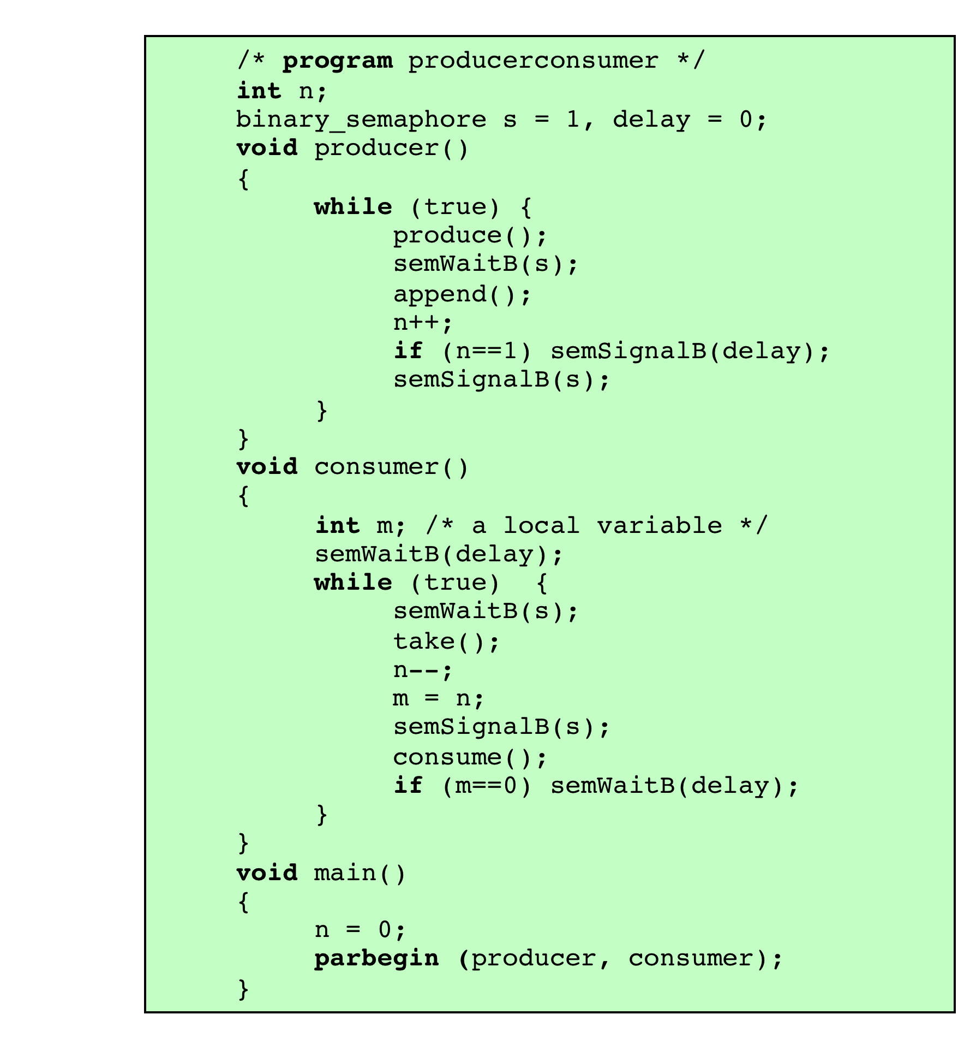
A Correct Solution to the Infinite-Buffer Producer/Consumer Problem Using Binary Semaphores
Notes:
A fix for the problem is to introduce an auxiliary variable that can be set in the consumer’s critical section for use later on. This is shown in Figure 5.10 . A careful trace of the logic should convince you that deadlock can no longer occur.

Slide 69
A Solution
to the Infinite-Buffer Producer/Consumer Problem Using Semaphores
Notes:
A somewhat cleaner solution can be obtained if general semaphores (also called counting semaphores) are used, as shown in Figure 5.11 . The variable n is now a semaphore. Its value still is equal to the number of items in the buffer. Suppose now that in transcribing this program, a mistake is made and the operations semSignal(s) and semSignal(n) are interchanged. This would require that the semSignal(n) operation be performed in the producer’s critical section without interruption by the consumer or another producer. Would this affect the program? No, because the consumer must wait on both semaphores before proceeding in any case.

Slide 70
Notes:
Finally, let us add a new and realistic restriction to the producer/consumer problem: namely, that the buffer is finite. The buffer is treated as a circular storage ( Figure 5.12 ), and pointer values must be expressed modulo the size of the buffer.

Slide 71
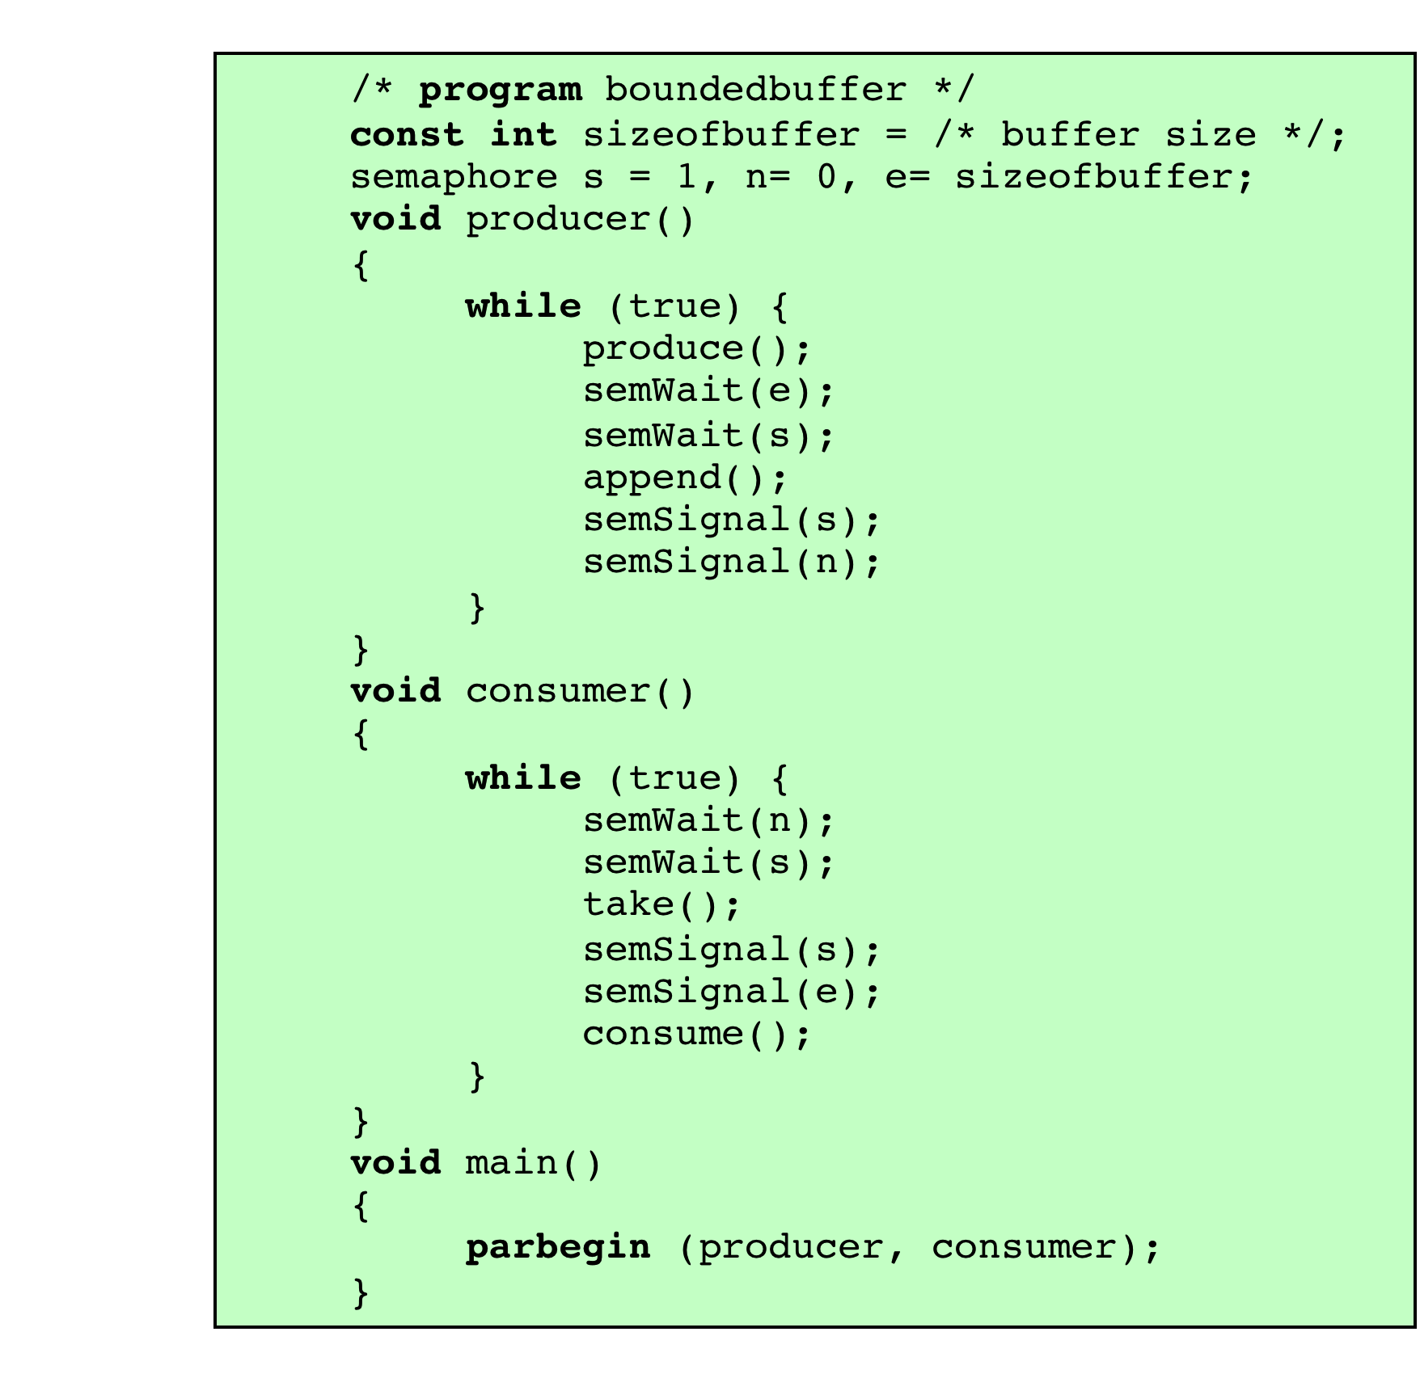
A Solution to the Bounded-Buffer Producer/Consumer Problem Using Semaphores
Notes:
Figure 5.13 shows a solution using general semaphores. The semaphore e has been added to keep track of the number of empty spaces.

Slide 72
Implementation of Semaphores
Imperative that the semWait and semSignal operations be implemented as atomic primitives
Can be implemented in hardware or firmware
Software schemes such as Dekker’s or Peterson’s algorithms can be used
Use one of the hardware-supported schemes for mutual exclusion
Notes:
As was mentioned earlier, it is imperative that the semWait and semSignal operations be implemented as atomic primitives. One obvious way is to implement them in hardware or firmware. Failing this, a variety of schemes have been suggested. The essence of the problem is one of mutual exclusion: Only one process at a time may manipulate a semaphore with either a semWait or semSignal operation. Thus, any of the software schemes, such as Dekker’s algorithm or Peterson’s algorithm ( Appendix A ), could be used; this would entail a substantial processing overhead.
Another alternative is to use one of the hardware-supported schemes for mutual exclusion.

Slide 73
Figure 5.14
Two Possible Implementations of Semaphores
(a) Compare and Swap Instruction (b) Interrupts
Notes:
Figure 5.14a shows the use of a compare&swap instruction.
In this implementation, the semaphore is again a structure, as in Figure 5.3,
but now includes a new integer component, s.flag . Admittedly, this involves a form
of busy waiting. However, the semWait and semSignal operations are relatively
short, so the amount of busy waiting involved should be minor.
For a single-processor system, it is possible to inhibit interrupts for the duration
of a semWait or semSignal operation, as suggested in Figure 5.14b. Once
again, the relatively short duration of these operations means that this approach is
reasonable.

Slide 74
1. The Bounded-Buffer Problem
In our problem, the producer and consumer processes share the following data structures:

Slide 75
2. The Readers–Writers Problem
Suppose that a database is to be shared among several concurrent processes. Some of these processes may want only to read the database, whereas others may want to update (that is, to read and write) the database.
Readers – only read the data set; they do not perform any updates
Writers – can both read and write
Problem – allow multiple readers to read at the same time
Only one single writer can access the shared data at the same time
To ensure that these difficulties do not arise, we require that the writers have exclusive access to the shared database while writing to the database. This synchronization problem is referred to as the readers–writers problem.
Since it was originally stated, it has been used to test nearly every new synchronization primitive. Several variations of how readers and writers are considered – all involve some form of priorities

Slide 76
2. The Readers–Writers Problem
The readers–writers problem has several variations, all involving priorities.
First variation –no reader be kept waiting unless a writer has already obtained permission to use the shared object. In other words, no reader should wait for other readers to finish simply because a writer is waiting.
Second variation once a writer is ready, that writer perform its write as soon as possible. In other words, if a writer is waiting to access the object, no new readers may start reading.
A solution to either problem may result in starvation. In the first case, writers may starve; in the second case, readers may starve.
For this reason, other variants of the problem have been proposed.
Problem is solved on some systems by kernel providing reader-writer locks
Notes:
The readers–writers problem and its solutions have been generalized to
provide reader–writer locks on some systems. Acquiring a reader–writer lock
requires specifying the mode of the lock: either read or write access. When a
process wishes only to read shared data, it requests the reader–writer lock
in read mode. A process wishing to modify the shared data must request the
lock in write mode. Multiple processes are permitted to concurrently acquire
a reader–writer lock in read mode, but only one process may acquire the lock
for writing, as exclusive access is required for writers.

Slide 77
Solution to the first readers–writers problem
the reader processes share the following data structures:
The semaphore rw_mutex is common to both reader and writer processes.
The mutex semaphore is used to ensure mutual exclusion when the variable read_count is updated.
The read_count variable keeps track of how many processes are currently reading the object.
The semaphore rw_mutex functions as a mutual exclusion semaphore for the writers.
It is also used by the first or last reader that enters or exits the critical section.
It is not used by readers who enter or exit while other readers are in their critical sections.

Slide 78
Readers-Writers Problem (Cont.)
The structure of a writer process
do { wait(rw_mutex);
... /* writing is performed */
...
signal(rw_mutex);
} while (true);

Slide 79
Readers-Writers Problem (Cont.)
The structure of a reader process
do { wait(mutex); read_count++; if (read_count == 1)
wait(rw_mutex);
signal(mutex);
... /* reading is performed */
...
wait(mutex); read count--; if (read_count == 0)
signal(rw_mutex);
signal(mutex);
} while (true);

Slide 80
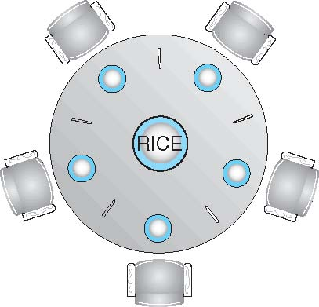
Dining-Philosophers Problem
Philosophers spend their lives alternating thinking and eating
Don’t interact with their neighbors, occasionally try to pick up 2 chopsticks (one at a time) to eat from bowl
Need both to eat, then release both when done
In the case of 5 philosophers
Shared data
Bowl of rice (data set)
Semaphore chopstick [5] initialized to 1
Notes:
The dining-philosophers problem is considered a classic synchronization
problem becauseit is an example of a large class
of concurrency-control problems. It is a simple representation of the need
to allocate several resources among several processes in a deadlock-free and
starvation-free manner.

Slide 81
Dining-Philosophers Problem Algorithm
The structure of Philosopher i:
do {
wait (chopstick[i] );
wait (chopStick[ (i + 1) % 5] );
// eat
signal (chopstick[i] );
signal (chopstick[ (i + 1) % 5] );
// think
} while (TRUE);
What is the problem with this algorithm?
Notes:
Although this solution guarantees that no two neighbors are eating
simultaneously, it nevertheless must be rejected because it could create a
deadlock. Suppose that all five philosophers become hungry at the same time
and each grabs her left chopstick. All the elements of chopstick will now be
equal to 0. When each philosopher tries to grab her right chopstick, she will be
delayed forever.

Slide 82
Dining-Philosophers Problem Algorithm (Cont.)
Deadlock handling:
Allow at most four philosophers to be sitting simultaneously at the table.
Allow a philosopher to pick up her chopsticks only if both chopsticks are available (to do this, she must pick them up in a critical section).
Use an asymmetric solution—that is, an odd-numbered philosopher picks up first her left chopstick and then her right chopstick, whereas an even numbered philosopher picks up her right chopstick and then her left chopstick.
Note, however, that any satisfactory solution to the dining-philosophers problem must guard against the possibility that one of the philosophers will starve to death. A deadlock-free solution does not necessarily eliminate the possibility of starvation.

Slide 83
Problems with Semaphores
Although semaphores provide a convenient and effective mechanism for process synchronization, using them incorrectly can result in timing errors that are difficult to detect, since these errors happen only if particular execution sequences take place and these sequences do not always occur.
Incorrect use of semaphore operations:
signal (mutex) …. wait (mutex)
wait (mutex) … wait (mutex)
Omitting of wait (mutex) or signal (mutex) (or both)
Deadlock and starvation are possible.
These examples illustrate that various types of errors can be generated easily when programmers use semaphores incorrectly to solve the critical-section problem.
Notes:
Suppose that a process interchanges the order in which the wait() and
signal() operations on the semaphore mutex are executed, resulting in
the following execution:
signal(mutex);
...
critical section
...
wait(mutex);
In this situation, several processesmaybe executing in their critical sections
simultaneously, violating the mutual-exclusion requirement. This error
may be discovered only if several processes are simultaneously active
in their critical sections. Note that this situation may not always be
reproducible.
• Suppose that a process replaces signal(mutex) with wait(mutex). That
is, it executes
wait(mutex);
...
critical section
...
wait(mutex);
In this case, a deadlock will occur.
• Suppose that a process omits the wait(mutex), or the signal(mutex), or
both. In this case, either mutual exclusion is violated or a deadlock will
occur.

Slide 84
Monitors
The monitor is a programming-language construct that provides equivalent functionality to that of semaphores and that is easier to control.
The monitor construct has been implemented in a number of programming languages, including Java, C#.
This allows programmers to put a monitor lock on any object.
In particular, for something like a linked list, you may want to lock all linked lists with one lock, or have one lock for each list, or have one lock for each element of each list.
Notes:
The monitor is a programming-language construct that provides equivalent functionality to that of semaphores and that is easier to control. The concept was first formally defined in [HOAR74]. The monitor construct has been implemented in a number of programming languages, including Concurrent Pascal, Pascal-Plus, Modula-2, Modula-3, and Java. It has also been implemented as a program library. This allows programmers to put a monitor lock on any object. In particular, for something like a linked list, you may want to lock all linked lists with one lock, or have one lock for each list, or have one lock for each element of each list.
A monitor is a software module consisting of one or more procedures, an initialization sequence, and local data.

Slide 85
Monitor with Signal
A monitor is a software module consisting of one or more procedures, an initialization sequence, and local data.
The chief characteristics of a monitor are the following:
Process enters monitor by invoking one of its procedures
Only one process may be executing in the monitor at a time; ; any other processes
that have invoked the monitor are blocked, waiting for the monitor to become available.
Local data variables are accessible only by the monitor’s procedures and not by any external procedure
Notes:
The first two characteristics are reminiscent of those for objects in object-oriented software. Indeed, an object-oriented OS or programming language can readily implement a monitor as an object with special characteristics.
By enforcing the discipline of one process at a time, the monitor is able to provide a mutual exclusion facility.
The data variables in the monitor can be accessed by only one process at a time. Thus, a shared data structure can be protected by placing it in a monitor.
If the data in a monitor represent some resource, then the monitor provides a mutual exclusion facility for accessing the resource.
To be useful for concurrent processing, the monitor must include synchronization tools. For example, suppose a process invokes the monitor and, while in the
monitor, must be blocked until some condition is satisfied. A facility is needed by which the process is not only blocked but releases the monitor so that some other process may enter it. Later, when the condition is satisfied and the monitor is again available, the process needs to be resumed and allowed to reenter the monitor at the point of its suspension.

Slide 87
The monitor construct ensures that only one process at a time is active within the monitor.
Consequently, the programmer does not need to code this synchronization constraint explicitly

Slide 88
Notes:
Figure 5.15 illustrates the structure of a monitor. Although a process can enter the monitor by invoking any of its procedures, we can think of the monitor as having a single entry point that is guarded so that only one process may be in the monitor at a time. Other processes that attempt to enter the monitor join a queue of processes blocked waiting for monitor availability. Once a process is in the monitor, it may temporarily block itself on condition x by issuing cwait(x) ; it is then placed in a queue of processes waiting to reenter the monitor when the condition changes, and resume execution at the point in its program following the cwait(x) call. If a process that is executing in the monitor detects a change in the condition variable x , it issues csignal(x) , which alerts the corresponding condition queue that the condition has changed.

Slide 89
Synchronization Requirement in Monitors
To be useful for concurrent processing, the monitor must include synchronization tools.
For example, suppose a process invokes the monitor and, while in the monitor, must be blocked until some condition is satisfied. A facility is needed by which the process is not only blocked but releases the monitor so that some other process may enter it. Later, when the condition is satisfied and the monitor is again available, the process needs to be resumed and allowed to reenter the monitor at the point of its suspension.

Slide 90
Synchronization in Monitors
A monitor supports synchronization by the use of condition variables that are contained within the monitor and accessible only within the monitor.
Condition variables are a special data type in monitors, which are operated on by two functions:
cwait (c): Suspend execution of the calling process on condition c. The monitor is now available for use by another process.
csignal (c): Resume execution of some process blocked after a cwait on the same condition. If there are several such processes, choose one of them; if there is no such process, do nothing.
Note that monitor wait and signal operations are different from those for the semaphore. If a process in a monitor signals and no task is waiting on the condition variable, the signal is lost.
Notes:
A monitor supports synchronization by the use of condition variables that are contained within the monitor and accessible only within the monitor. Condition variables are a special data type in monitors, which are operated on by two functions:
• cwait(c) : Suspend execution of the calling process on condition c . The monitor is now available for use by another process.
• csignal(c) : Resume execution of some process blocked after a cwait on the same condition. If there are several such processes, choose one of them; if there is no such process, do nothing.
Note that monitor wait and signal operations are different from those for the semaphore. If a process in a monitor signals and no task is waiting on the condition variable, the signal is lost.

Slide 91
Dining-Philosophers Solution Using Monitors
A deadlock-free solution to the dining-philosophers problem.
This solution imposes the restriction that a philosopher may pick up her chopsticks only if both of them are available.
To code this solution, we need to distinguish among three states in which we may find a philosopher. For this purpose, we introduce the following data structure:
enum {THINKING, HUNGRY, EATING} state[5];
Philosopher i can set the variable state[i] = EATING only if her two neighbors are not eating:
(state[(i+4) % 5] != EATING) and(state[(i+1) % 5] != EATING)
We also need to declare:
condition self[5];
This allows philosopher i to delay herself when she is hungry but is unable to obtain the chopsticks she needs.

Slide 92
Dining-Philosophers Solution Using Monitors
Notes:
Each philosopher, before starting to eat, must invoke the operation pickup().
This act may result in the suspension of the philosopher process.
After the successful completion of the operation, the philosopher may eat.
Following this, the philosopher invokes the putdown() operation.
Thus, philosopher i must invoke the operations pickup() and putdown() in the following sequence:

Slide 93
DiningPhilosophers.pickup(i);
...
eat
...
DiningPhilosophers.putdown(i);
It is easy to show that this solution ensures that no two neighbors are eating simultaneously and that no deadlocks will occur.
We note, however, that it is possible for a philosopher to starve to death.

Slide 94
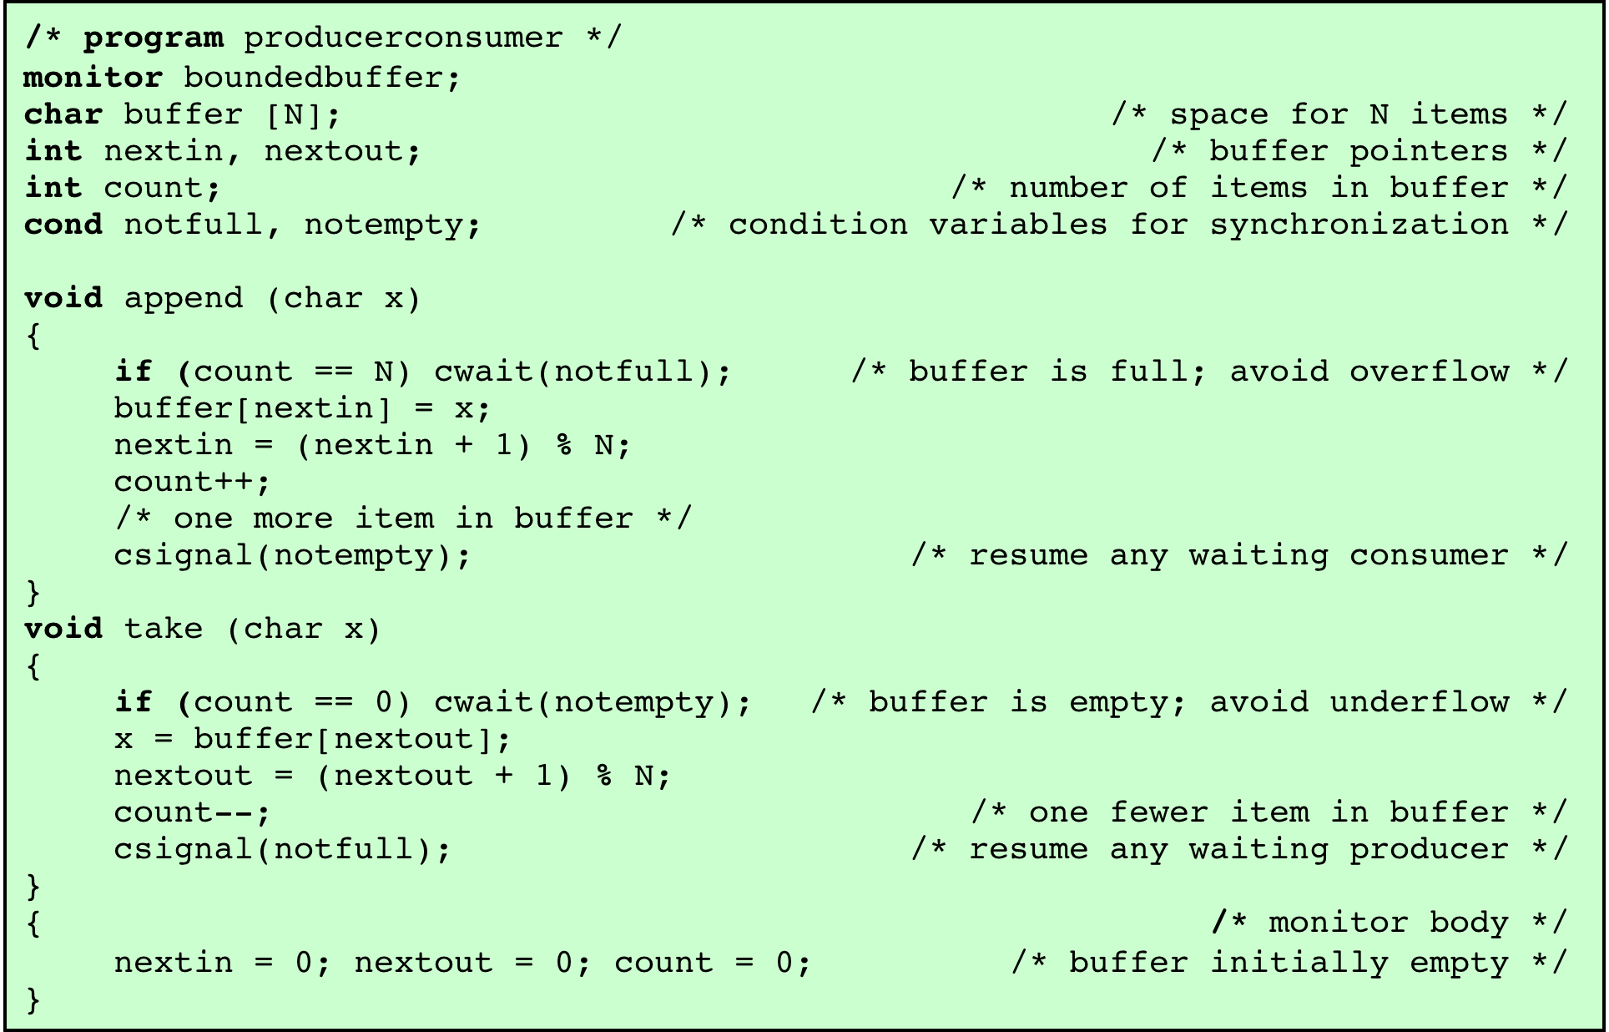
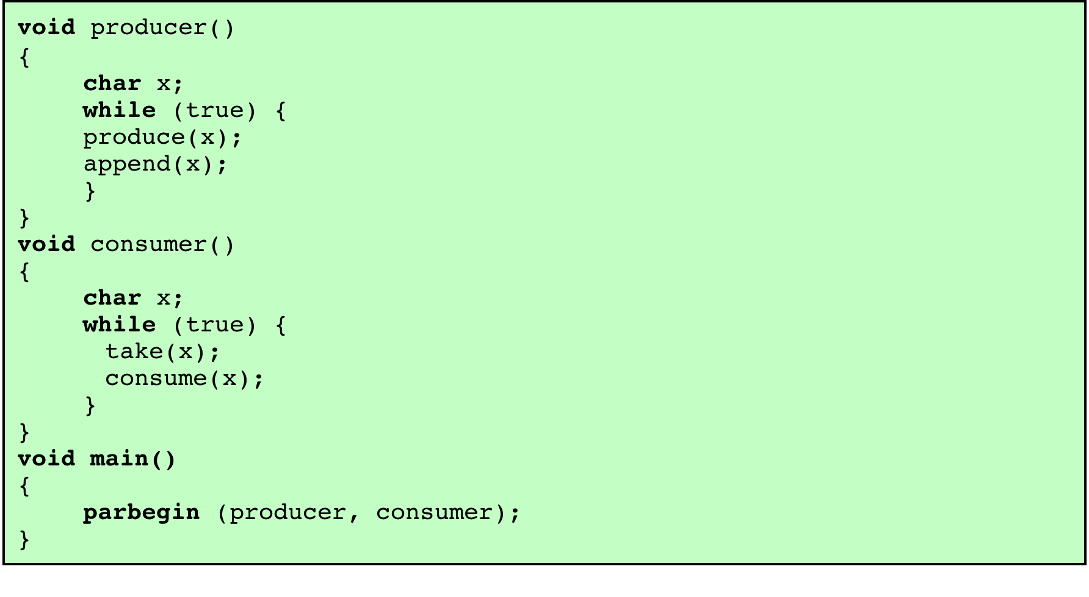
A Solution to the Bounded-Buffer Producer/Consumer Problem Using a Monitor
Notes:
As an example of the use of a monitor, let us return to the bounded-buffer producer/consumer problem. Figure 5.16 shows a solution using a monitor. The monitor module, boundedbuffer , controls the buffer used to store and retrieve characters. The monitor includes two condition variables (declared with the construct cond ): notfull is true when there is room to add at least one character to the buffer, and notempty is true when there is at least one character in the buffer.
A producer can add characters to the buffer only by means of the procedure append inside the monitor; the producer does not have direct access to buffer . The procedure first checks the condition notfull to determine if there is space available in the buffer. If not, the process executing the monitor is blocked on that condition. Some other process (producer or consumer) may now enter the monitor. Later, when the buffer is no longer full, the blocked process may be removed from the queue, reactivated, and resume processing. After placing a character in the buffer, the process signals the notempty condition. A similar description can be made of the consumer function.
This example points out the division of responsibility with monitors compared to semaphores. In the case of monitors, the monitor construct itself enforces mutual exclusion: It is not possible for both a producer and a consumer simultaneously to access the buffer. However, the programmer must place the appropriate cwait and csignal primitives inside the monitor to prevent processes from depositing items in a full buffer or removing them from an empty one. In the case of semaphores, both mutual exclusion and synchronization are the responsibility of the programmer.
Note that in Figure 5.16 , a process exits the monitor immediately after executing the csignal function. If the csignal does not occur at the end of the procedure, then, in Hoare’s proposal, the process issuing the signal is blocked to make the monitor available and placed in a queue until the monitor is free. One possibility at this point would be to place the blocked process in the entrance queue, so that it would have to compete for access with other processes that had not yet entered the monitor. However, because a process blocked on a csignal function has already partially performed its task in the monitor, it makes sense to give this process precedence over newly entering processes by setting up a separate urgent queue ( Figure 5.15 ). One language that uses monitors, Concurrent Pascal, requires that csignal only appear as the last operation executed by a monitor procedure.
If there are no processes waiting on condition x , then the execution of csignal( x ) has no effect.
As with semaphores, it is possible to make mistakes in the synchronization function
of monitors. For example, if either of the csignal functions in the boundedbuffer
monitor are omitted, then processes entering the corresponding condition
queue are permanently hung up. The advantage that monitors have over semaphores
is that all of the synchronization functions are confined to the monitor. Therefore, it
is easier to verify that the synchronization has been done correctly and to detect bugs.
Furthermore, once a monitor is correctly programmed, access to the protected resource
is correct for access from all processes. In contrast, with semaphores, resource access is
correct only if all of the processes that access the resource are programmed correctly.

